Slide 1
CS 590 Algorithm
Chapter 11 Divide-and-Conquer
Source: Goodrich, M. T., & Tamassia, R. (2015). Algorithm Design and Applications. Hoboken, NJ: Wiley.

Slide 2
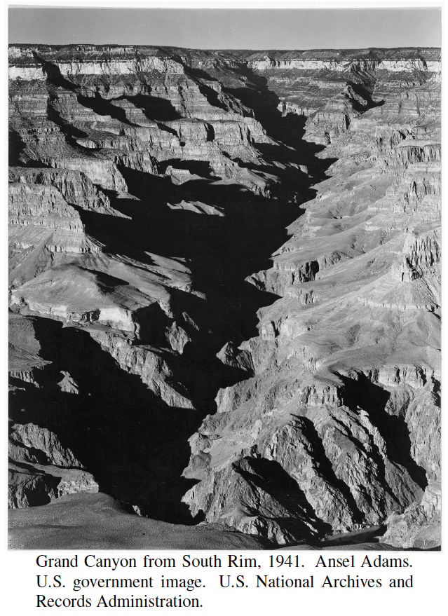
Divide-and-Conquer
Presentation for use with the textbook, Algorithm Design and Applications, by M. T. Goodrich and R. Tamassia, Wiley, 2015

Slide 3
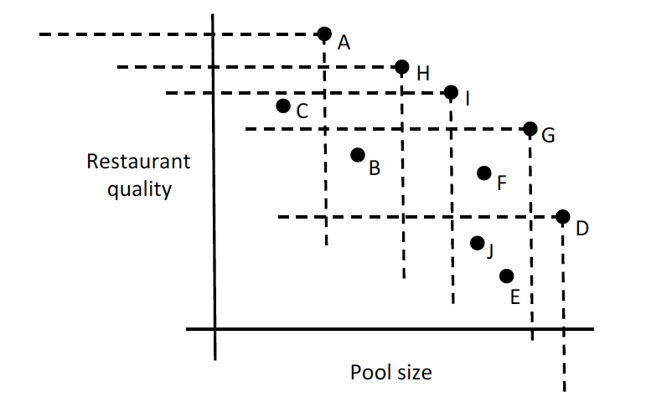
Application: Maxima Sets
We can visualize the various trade-offs for optimizing two-dimensional data, such as points representing hotels according to their pool size and restaurant quality, by plotting each as a two-dimensional point, (x, y), where x is the pool size and y is the restaurant quality score.
We say that such a point is a maximum point in a set if there is no other point, (x′, y′), in that set such that x ≤ x′ and y ≤ y′.
The maximum points are the best potential choices based on these two dimensions and finding all of them is the maxima set problem.
We discuss solution at the end.
We can efficiently find all
the maxima points
by divide-and-conquer.
Here the set is {A,H,I,G,D}.

Slide 4
Divide-and-Conquer
Divide-and conquer is a general algorithm design paradigm:
Divide: divide the input data S in two or more disjoint subsets S₁, S₂, …
Conquer: solve the subproblems recursively
Combine: combine the solutions for S₁, S₂, …, into a solution for S
The base case for the recursion are subproblems of constant size
Analysis can be done using recurrence equations

Slide 5
Merge-Sort Review
Merge-sort on an input sequence S with n elements consists of three steps:
Divide: partition S into two sequences S₁ and S₂ of about n/2 elements each
Conquer: recursively sort S₁ and S₂
Combine: merge S₁ and S₂ into a unique sorted sequence
Algorithm mergeSort(S)
Input sequence S with n elements
Output sequence S sorted
according to C
if S.size() > 1
(S₁, S₂) ← partition(S, n/2)
mergeSort(S₁)
mergeSort(S₂)
S ← merge(S₁, S₂)

Slide 6
Recurrence Equation Analysis
The conquer step of merge-sort consists of merging two sorted sequences, each with n/2 elements and implemented by means of a doubly linked list, takes at most bn steps, for some constant b.
Likewise, the basis case (n < 2) will take at b most steps.
Therefore, if we let T(n) denote the running time of merge-sort:
We can therefore analyze the running time of merge-sort by finding a closed form solution to the above equation.
That is, a solution that has T(n) only on the left-hand side.

Slide 7
Iterative Substitution
In the iterative substitution, or “plug-and-chug,” technique, we iteratively apply the recurrence equation to itself and see if we can find a pattern:
Note that base, T(1)=b, case occurs when 2^{i}=n. That is, i = log n.
So,
Thus, T(n) is O(n log n).

Slide 8
The Recursion Tree
Draw the recursion tree for the recurrence relation and look for a pattern:
depth | T’s | size
0 | 1 | n
1 | 2 | n/2
i | 2^{i} | n/2^{i}
… | … | …
time
bn
bn
bn
…
Total time = bn + bn log n
(last level plus all previous levels)

Slide 9
Guess-and-Test Method
In the guess-and-test method, we guess a closed form solution and then try to prove it is true by induction:
Guess: T(n) <= cn log n.
Wrong: we cannot make this last line be less than cn log n

Slide 10
Guess-and-Test Method, (cont.)
Recall the recurrence equation:
Guess #2: T(n) < cn log² n.
if c > b.
So, T(n) is O(n log² n).
In general, to use this method, you need to have a good guess and you need to be good at induction proofs.

Slide 11
Master Method
Many divide-and-conquer recurrence equations have the form:
The Master Theorem:

Slide 12
Master Method, Example 1
The form:
The Master Theorem:
Example:
Solution: log_{b}a=2, so case 1 says T(n) is θ(n²) hence also O(n²).

Slide 13
Master Method, Example 2
The form:
The Master Theorem:
Example:
Solution: log_{b}a=1, so case 2 says T(n) is O(n log² n).

Slide 14
Master Method, Example 3
The form:
The Master Theorem:
Example:
Solution: log_{b}a=0, so case 3 says T(n) is O(n log n).

Slide 15
Master Method, Example 4
The form:
The Master Theorem:
Example:
Solution: log_{b}a=3, so case 1 says T(n) is O(n³).

Slide 16
Master Method, Example 5
The form:
The Master Theorem:
Example:
Solution: log_{b}a=2, so case 3 says T(n) is O(n³).

Slide 17
Master Method, Example 6
The form:
The Master Theorem:
Example:
(binary search)
Solution: log_{b}a=0, so case 2 says T(n) is O(log n).

Slide 18
Master Method, Example 7
The form:
The Master Theorem:
Example:
(heap construction)
Solution: log_{b}a=1, so case 1 says T(n) is O(n).

Slide 19
Sketch of Proof of the Master Theorem
Using iterative substitution, let us see if we can find a pattern:
We then distinguish the three cases as
The first term is dominant
Each part of the summation is equally dominant
The summation is a geometric series

Slide 20
Integer Multiplication
Algorithm: Multiply two n-bit integers I and J.
Divide step: Split I and J into high-order and low-order bits
We can then define I*J by multiplying the parts and adding:
So, T(n) = 4T(n/2) + n, which implies T(n) is O(n²).
But that is no better than the algorithm we learned in grade school.

Slide 21
An Improved Integer Multiplication Algorithm
Algorithm: Multiply two n-bit integers I and J.
Divide step: Split I and J into high-order and low-order bits
Observe that there is a different way to multiply parts:
So, T(n) = 3T(n/2) + n, which implies T(n) is O(n^{log}₂³), by the Master Theorem.
Thus, T(n) is O(n^{1.585}).

Slide 22
Solving the Maxima Set Problem
Let us now return to the problem of finding a maxima set for a set, S, of n points in the plane.
This problem is motivated from multi-objective optimization, where we are interested in optimizing choices that depend on multiple variables.
For instance, in the introduction we used the example of someone wishing to optimize hotels based on the two variables of pool size and restaurant quality.
A point is a maximum point in S if there is no other point, (x′, y′), in S such that x ≤ x′ and y ≤ y′.

Slide 23
Divide-and-Conquer Solution
Given a set, S, of n points in the plane, there is a simple divide-and-conquer algorithm for constructing the maxima set of points in S.
If n ≤ 1, the maxima set is just S itself.
Otherwise, let p be the median point in S according to a lexicographic ordering of the points in S, that is, where we order based primarily on x-coordinates and then by y-coordinates if there are ties.
Next, we recursively solve the maxima-set problem for the set of points on the left of this line and also for the points on the right.
Given these solutions, the maxima set of points on the right are also maxima points for S.
But some of the maxima points for the left set might be dominated by a point from the right, namely the point, q, that is leftmost.
So then we do a scan of the left set of maxima, removing any points that are dominated by q, until reaching the point where q’s dominance extends.
The union of remaining set of maxima from the left and the maxima set from the right is the set of maxima for S.

Slide 24
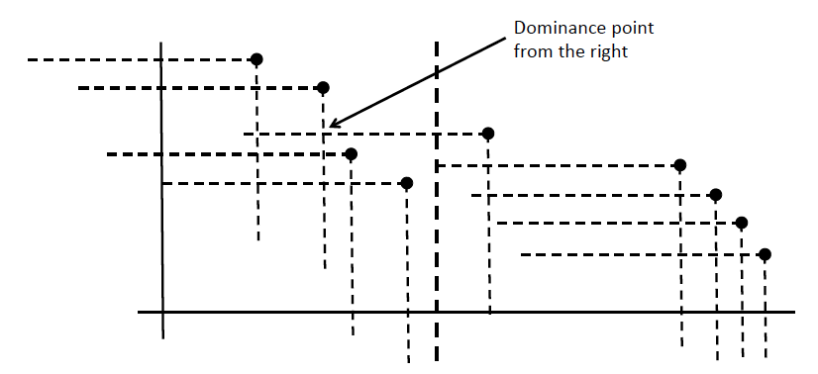
Example for the Combine Step

Slide 25
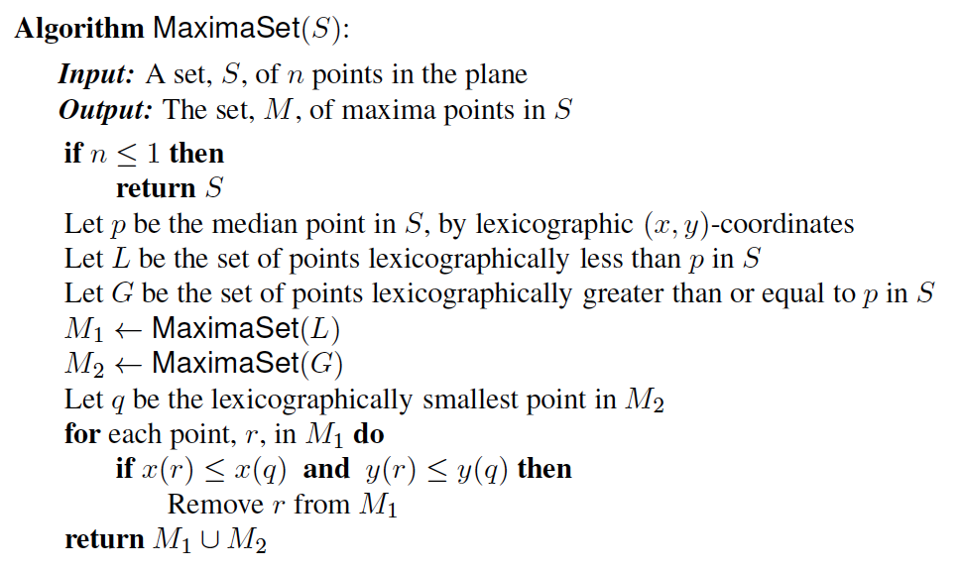
Pseudo-code

Slide 26
A Little Implementation Detail
Before we analyze the divide-and-conquer maxima-set algorithm, there is a little implementation detail that we need to work out.
Namely, there is the issue of how to efficiently find the point, p, that is the median point in a lexicographical ordering of the points in S according to their (x, y)-coordinates.
There are two immediate possibilities:
One choice is to use a linear-time median-finding algorithm, such as that given in Section 9.2 (Quickselect). This achieves a good asymptotic running time O(n).
Another choice is to sort the points in S lexicographically by their (x, y)-coordinates as a preprocessing step, prior to calling the MaxmaSet algorithm on S. Given this preprocessing step, the median point is simply the point in the middle of the list.

Slide 27
Analysis
In either case, the rest of the non-recursive steps can be performed in O(n) time, so this implies that, ignoring floor and ceiling functions (as allowed by the analysis of Exercise C-11.5), the running time for the divide-and-conquer maxima-set algorithm can be specified as follows (where b is a constant):
Thus, according to the Master Theorem, this algorithm runs in O(n log n) time.

Slide 28
About Stevens
A premier, private research university with a mission to inspire, nurture and educate leaders in tomorrow’s technology-centric environment while contributing to the solution of the most challenging problems of our time

